Slide 1
Chapter 8
Encipherment Using
Modern Symmetric-Key Ciphers
8.<number>

Slide 2
Chapter 18
Objectives
❏ To show how modern standard ciphers, such as
DES or AES, can be used to encipher long
messages.
❏ To discuss five modes of operation designed to be
used with modern block ciphers.
❏ To define which mode of operation creates stream
ciphers out of the underlying block ciphers.
❏ To discuss the security issues and the error
propagation of different modes of operation.
8.<number>

Slide 3
8-1 USE OF MODERN BLOCK CIPHERS
Symmetric-key encipherment can be done using modern block ciphers. Modes of operation have been devised to encipher text of any size employing either DES or AES.
Topics discussed in this section:
8.1.1 Electronic Codebook (ECB) Mode
8.1.2 Cipher Block Chaining (CBC) Mode
8.1.3 Cipher Feedback (CFB) Mode
8.1.4 Output Feedback (OFB) Mode
8.1.5 Counter (CTR) Mode
8.<number>

Slide 4
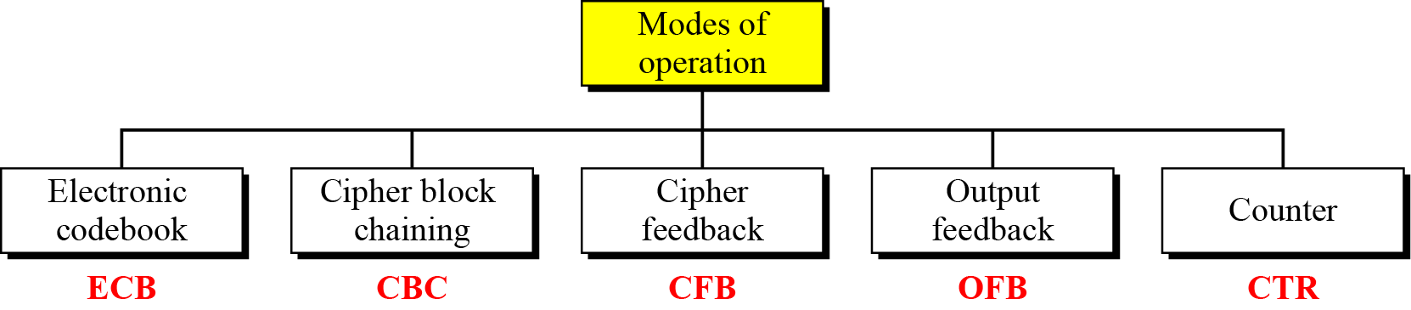
8-1 Continued
Figure 8.1 Modes of operation
8.<number>

Slide 5

Block Ciphers
The message is broken into blocks,
  Each of which is then encrypted
  (Like a substitution on very big characters - 64-bits or more)
  Key
8.<number>

Slide 6
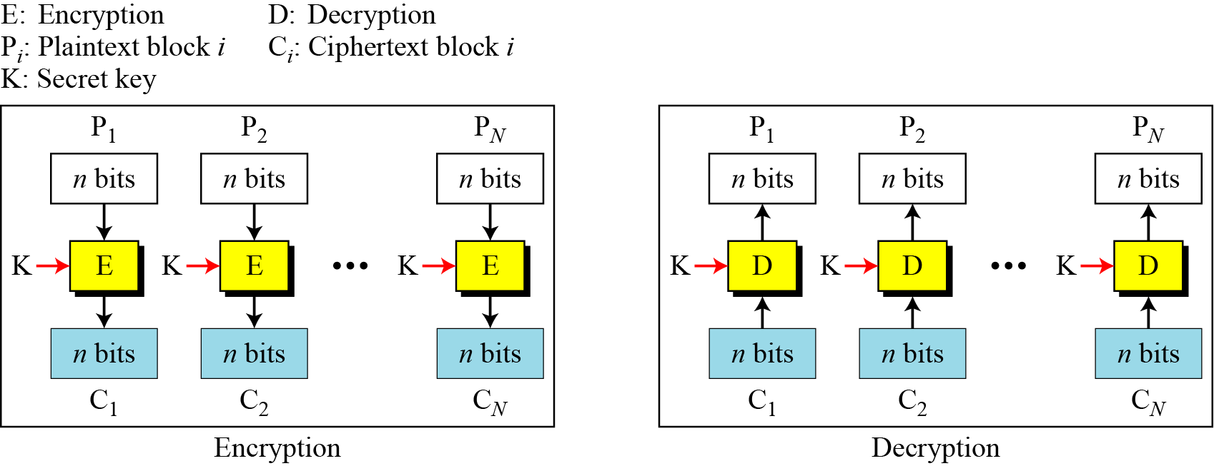
8.1.1 Electronic Codebook (ECB) Mode
The simplest mode of operation is called the electronic codebook (ECB) mode.
Figure 8.2 Electronic codebook (ECB) mode
8.<number>

Slide 7
8.1.1 Continued
This mode is called electronic codebook
because one can precompile 2^{K} codebooks (one for each key) in which each codebook has 2^{n} entries in two columns. Each entry can list the plaintext and the corresponding ciphertext blocks. However, if K and n are large, the codebook would be far too large to precompile and maintain.
Adv: - good for small messages.
- simple.
Disadv: - patterns at the block level are preserved.
i.e. the same P.T. block if repeated, produces the same C.T. block.
8.<number>

Slide 8
8.1.1 Continued
Example 8.3
Assume that Eve works in a company a few hours per month (her monthly payment is very low). She knows that the company uses several blocks of information for each employee in which the seventh block is the amount of money to be deposited in the employee’s account.
Eve can intercept the ciphertext sent to the bank at the end of the month, replace the block with the information about her payment with a copy of the block with the information about the payment of a full-time colleague.
Each month Eve can receive more money than she deserves.
8.<number>

Slide 9
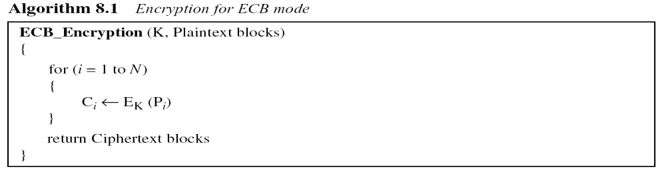
8.1.1 Continued
Error Propagation:
A single bit error in transmission can create errors in several in the corresponding block. However, the error does not have any effect on the other blocks.
8.<number>

Slide 10
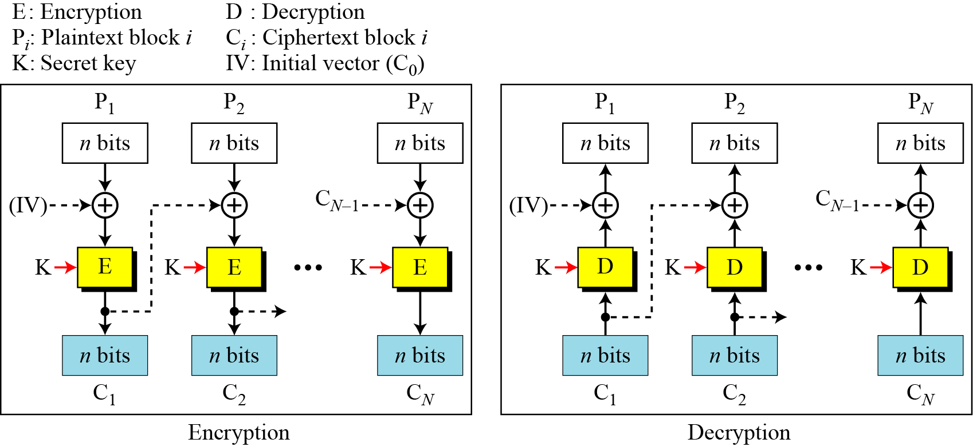
8.1.2 Cipher Block Chaining (CBC) Mode
In CBC mode, each plaintext block is exclusive-ored with the previous ciphertext block before being encrypted.
Figure 8.3 Cipher block chaining (CBC) mode
8.<number>

Slide 11
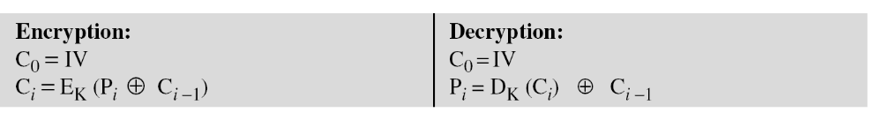
8.1.2 Continued
Figure 8.3 Cipher block chaining (CBC) mode
8.<number>

Slide 12
8.1.2 Continued
Example 8.4
It can be proved that each plaintext block at Alice’s site is recovered exactly at Bob’s site. Because encryption and decryption are inverses of each other,
Initialization Vector (IV)
The initialization vector (IV) should be known by the sender and the receiver.
8.<number>

Slide 13
8.1.2 Continued
Adv:
- The pattern at the block level are not preserved.
- can be used for authentication.
Disadv:
- Error Propagation
In CBC mode, a single bit error in ciphertext block C_{j} during transmission may create error in most bits in plaintext block P_{j} during decryption.
8.<number>

Slide 14
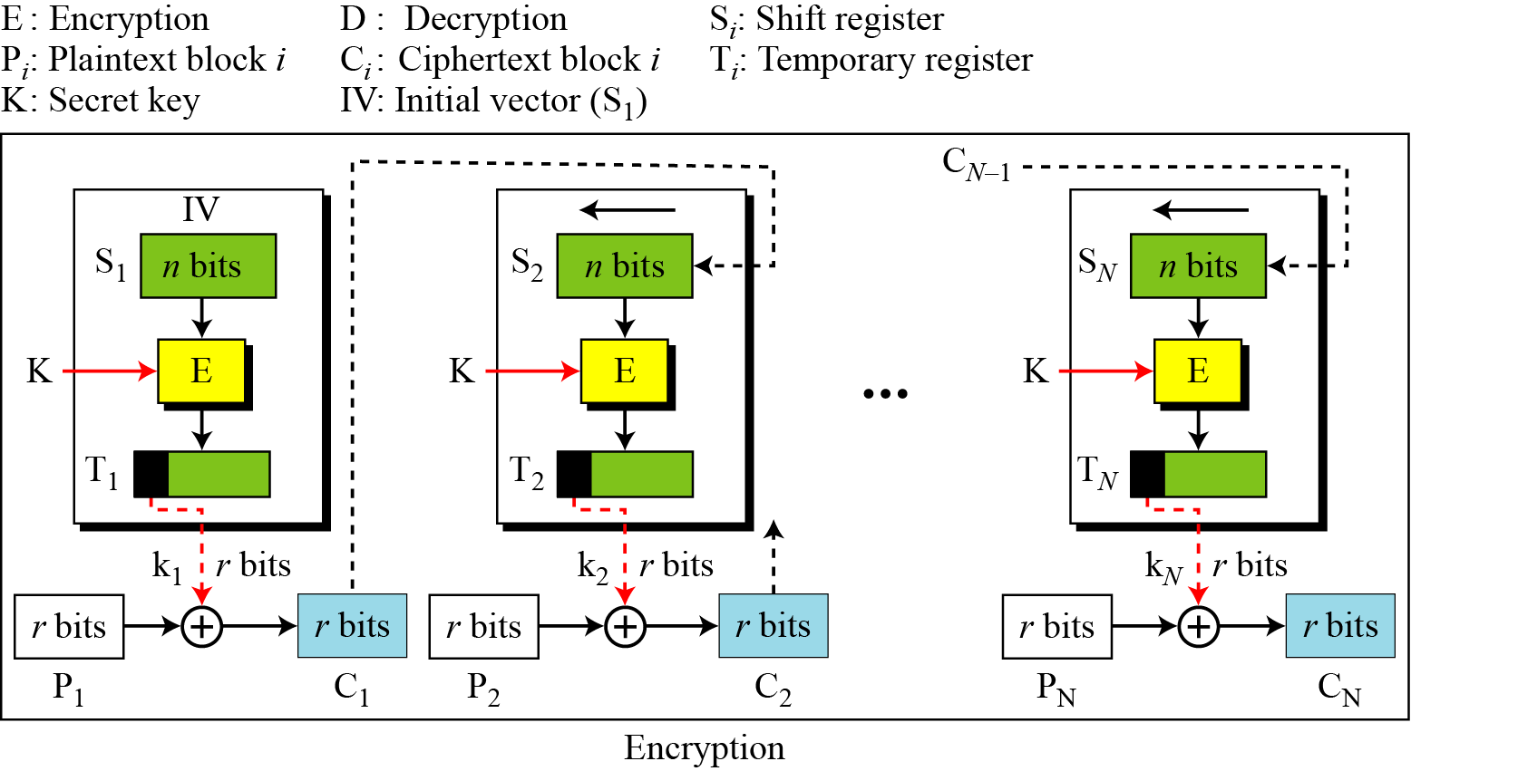
8.1.3 Cipher Feedback (CFB) Mode
In some situations, we need to use DES or AES as secure ciphers, but the plaintext or ciphertext block sizes are to be smaller. (8-bits or less)
Figure 8.4 Encryption in cipher feedback (CFB) mode
8.<number>

Slide 15
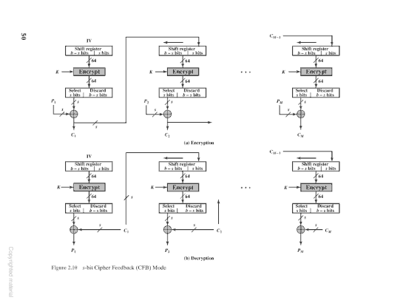
8.1.3 Cipher Feedback (CFB) Mode
Figure 8.4 Encryption in cipher feedback (CFB) mode
8.<number>

Slide 16

8.1.3 Continued
Note
In CFB mode, encipherment and decipherment use the encryption function of the underlying block cipher.
The relation between plaintext and ciphertext blocks is shown below:
8.<number>

Slide 17
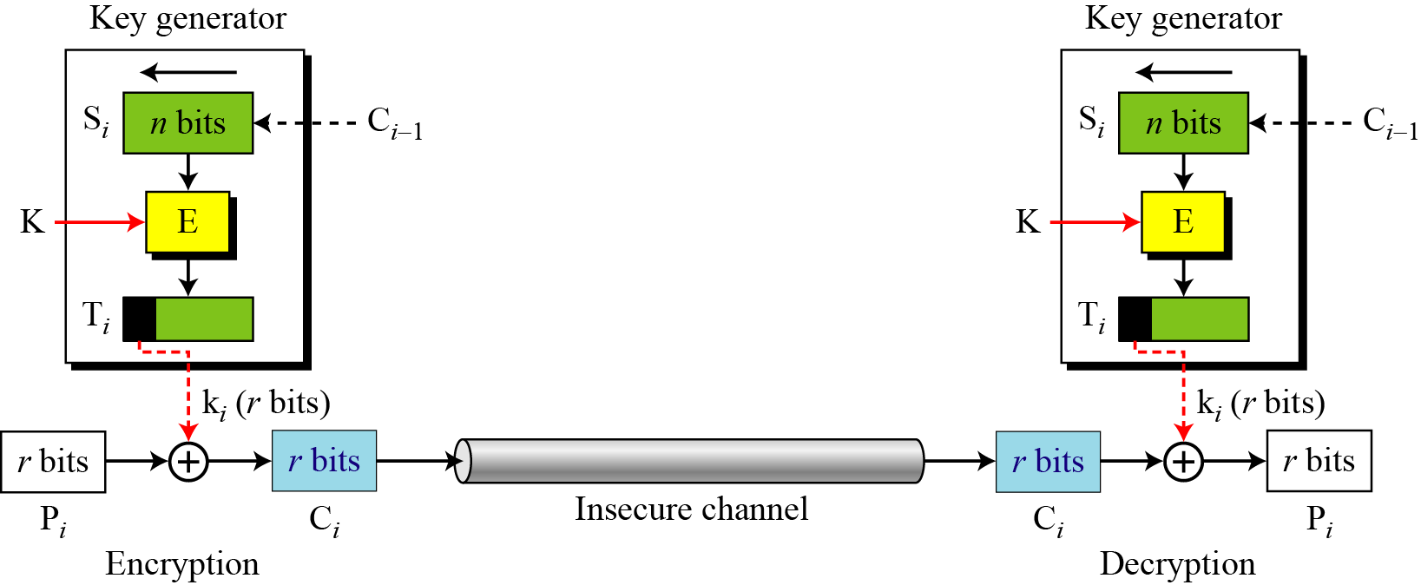
8.1.3 Continued
CFB as a Stream Cipher
Figure 8.5 Cipher feedback (CFB) mode as a stream cipher
8.<number>

Slide 18
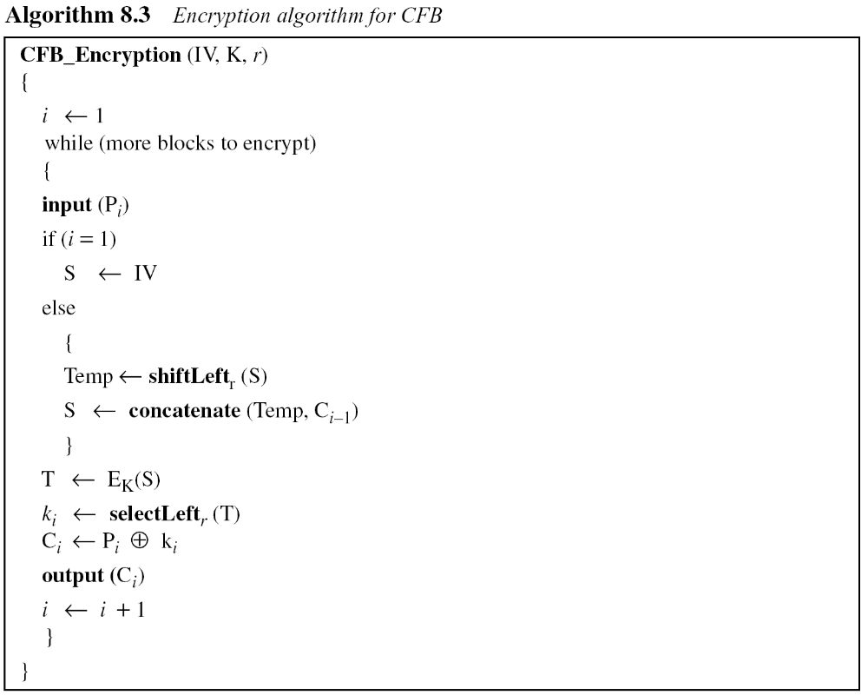
8.1.3 Continued
8.<number>

Slide 19
Advantages:
-patterns are not preserved.
-no padding is required.
-it does not have to wait for a large block of data (64/128) bits before starting encryption.
Error propagation:
-a single bit error in C.T. creates a single bit error in P.T.
8.<number>

Slide 20
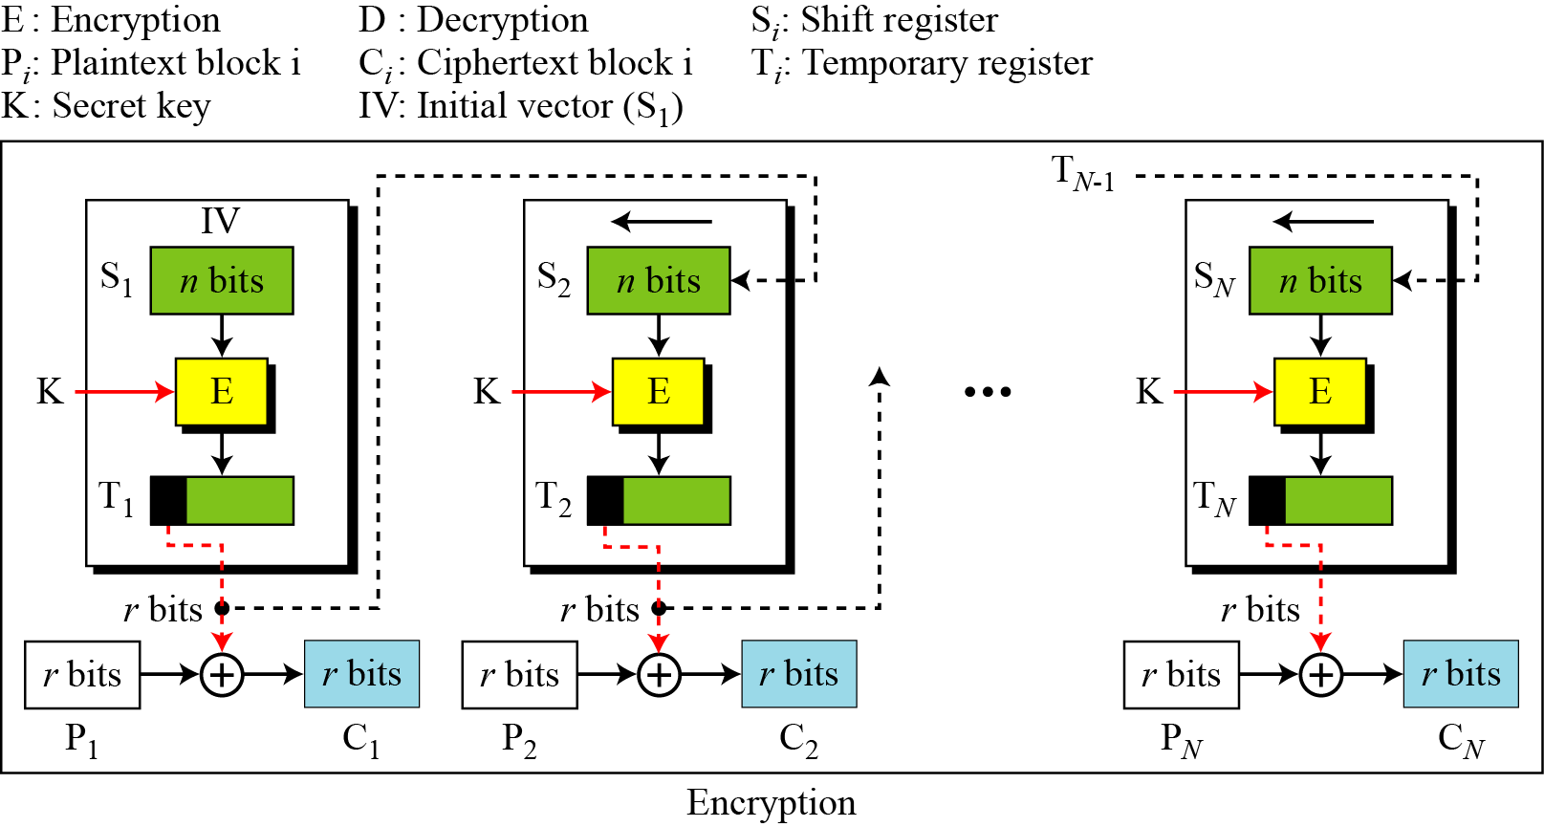
18.1.4 Output Feedback (OFB) Mode
In this mode each bit in the ciphertext is independent of the previous bit or bits. This avoids error propagation.
Figure 8.6 Encryption in output feedback (OFB) mode
8.<number>

Slide 21
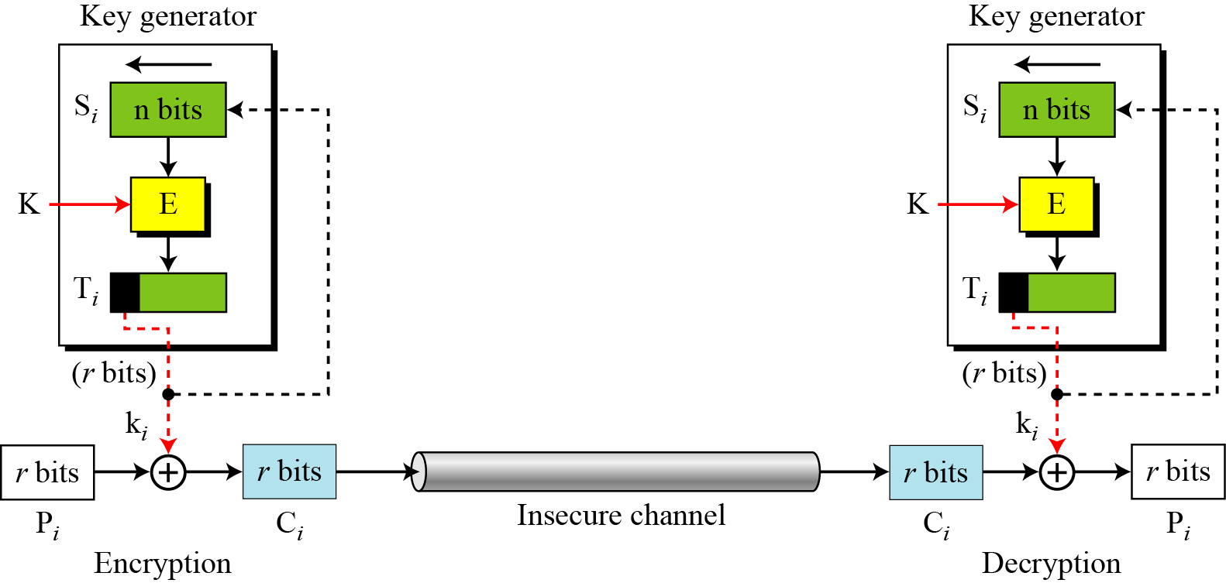
8.1.4 Continued
OFB as a Stream Cipher
Figure 8.7 Output feedback (OFB) mode as a stream cipher
8.<number>

Slide 22
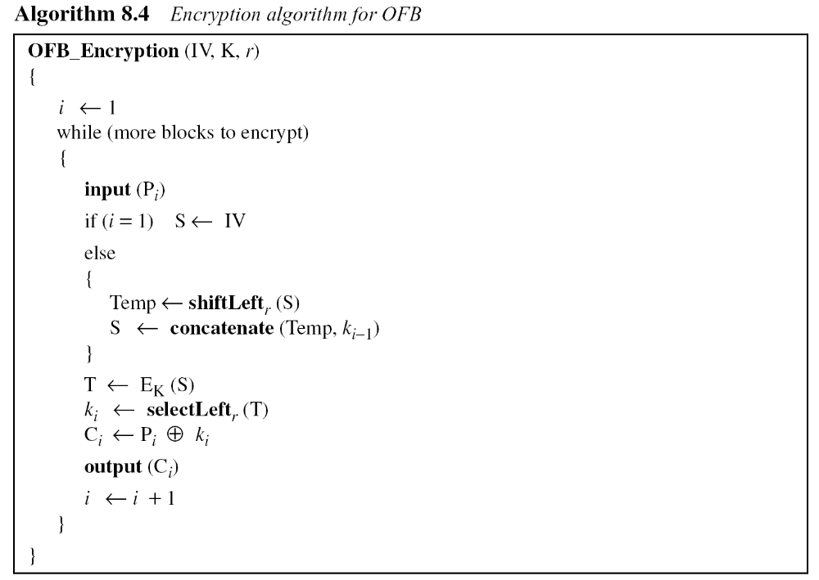
8.1.4 Continued
8.<number>

Slide 23
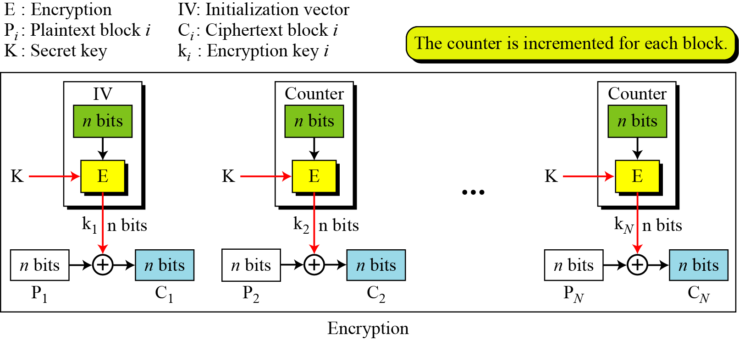
8.1.5 Counter (CTR) Mode
In the counter (CTR) mode, there is no feedback. The pseudorandomness in the key stream is achieved using a counter.
Figure 8.8 Encryption in counter (CTR) mode
8.<number>

Slide 24
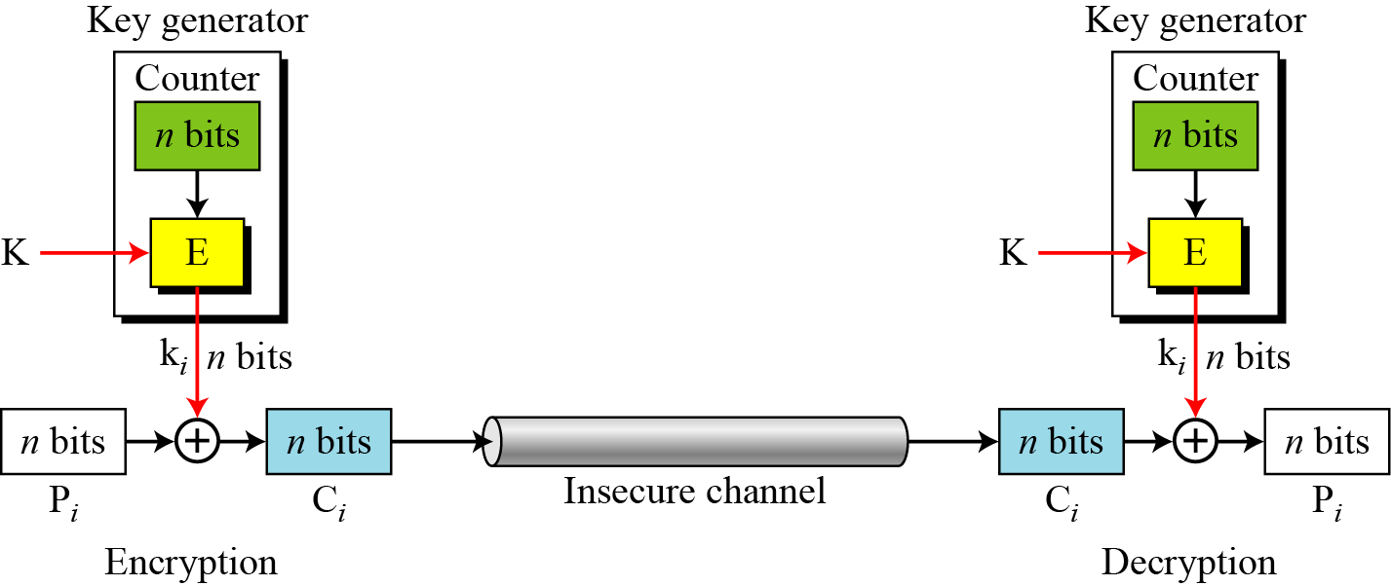
8.1.5 Continued
Figure 8.9 Counter (CTR) mode as a stream cipher
8.<number>

Slide 25
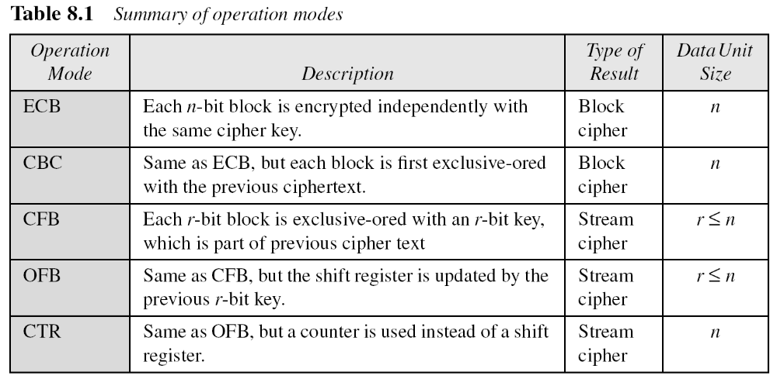
8.1.5 Continued
Comparison of Different Modes
8.<number>

Slide 26
8-2 USE OF STREAM CIPHERS
Although the five modes of operations enable the use of block ciphers for encipherment of messages or files in large units and small units, sometimes pure stream are needed for enciphering small units of data such as characters or bits.
Topics discussed in this section:
8.2.1 RC4
8.2.2 A5/1
8.<number>

Slide 27
8.2.1 RC4
RC4 - is a byte-oriented
- stream cipher
- in which a byte (8 bits) of a plaintext is exclusive-ored(XOR) with a byte of key to produce a byte of a ciphertext.
is used in popular protocols
such as Secure Sockets Layer (SSL)
(to protect Internet traffic)
and WEP (Wired Equivalent Privacy)
(to secure wireless networks).
8.<number>

Slide 28
8.2.1 RC4
Uses two array, state(S) and key(K)
State
RC4 is based on the concept of a state.
The key (8-bits) is randomly selected from an active state of 256 bytes.
8.<number>

Slide 29
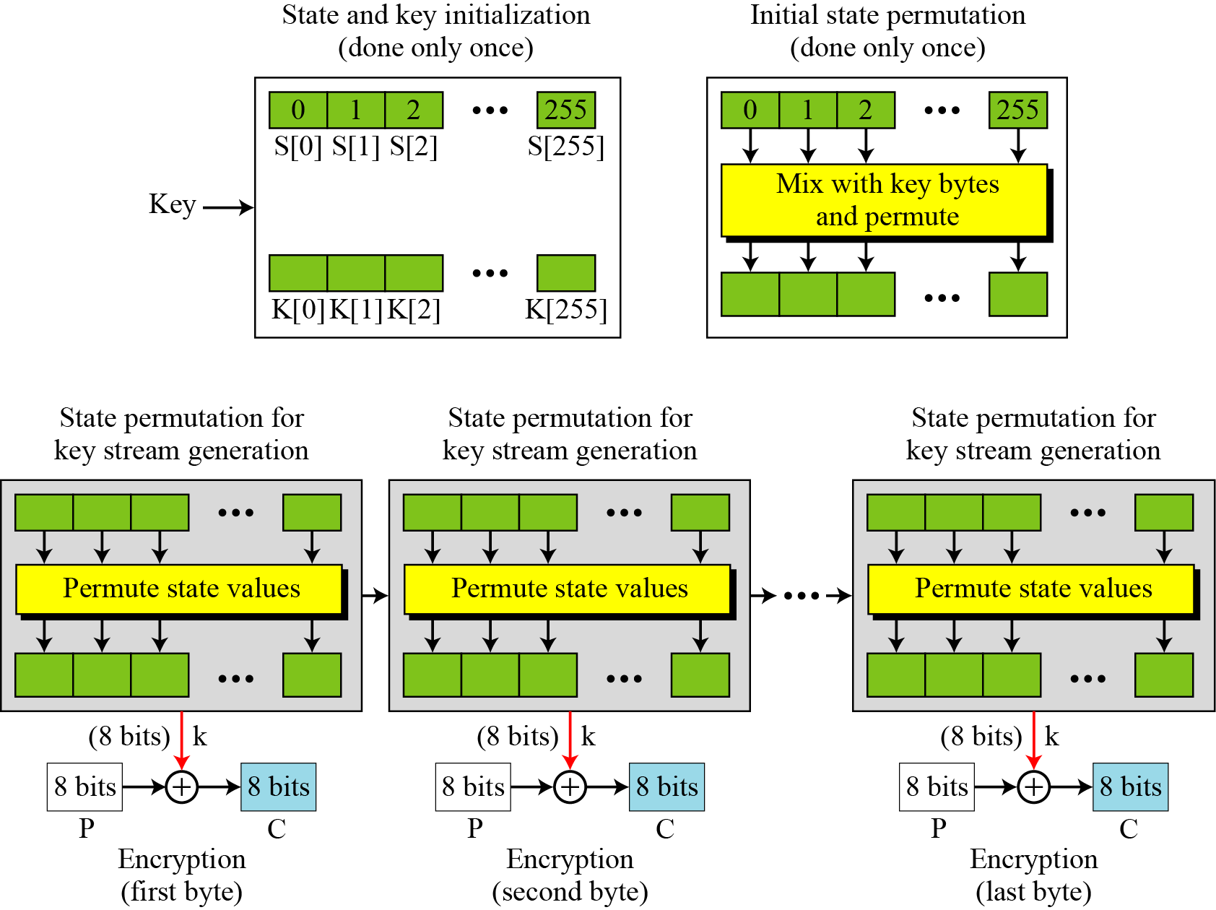
8.2.1
Figure 8.10 The idea of RC4 stream cipher
8.<number>

Slide 30
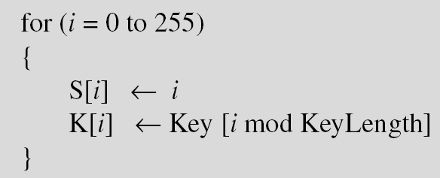
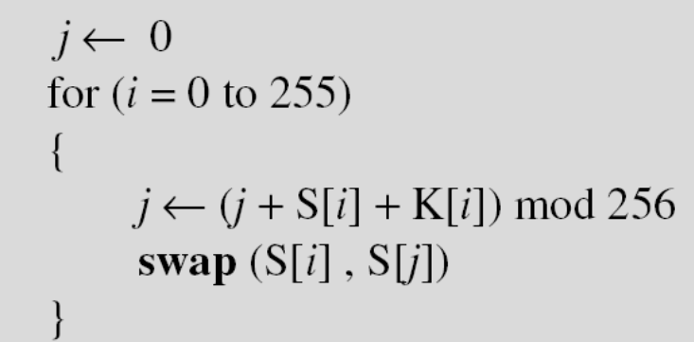
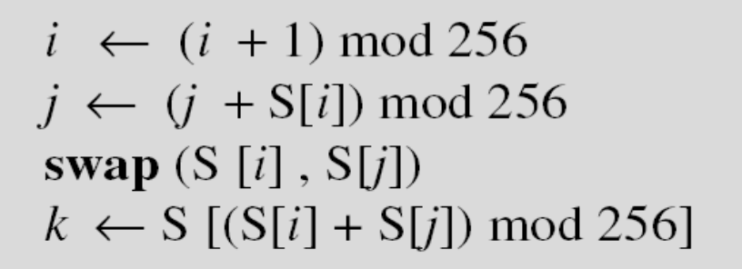
8.2.1 Continued
Initialization
Initialization is done in two steps:
Key Stream Generation
The keys in the key stream are generated, one by one.
8.<number>

Slide 31
Initial stage permutation (only once)
S[0] S[1] S[2] S[255]
0 1 2 255
1 255 15 4
K[0] K[1] K[2] K[255]
Iteration 1
J=0, i=0;
J= j+S[i]+K[i] mod 256 = (0+0+1) mod 256 = 1
Swap (s[0], s[1])
Iteration 2
J=1, i=1;
J= j+S[i]+K[i] mod 256 = (1+1+255) mod 256 = 1, Swap (s[1], s[1])
MIX AND PERMUTE
8.<number>

Slide 32
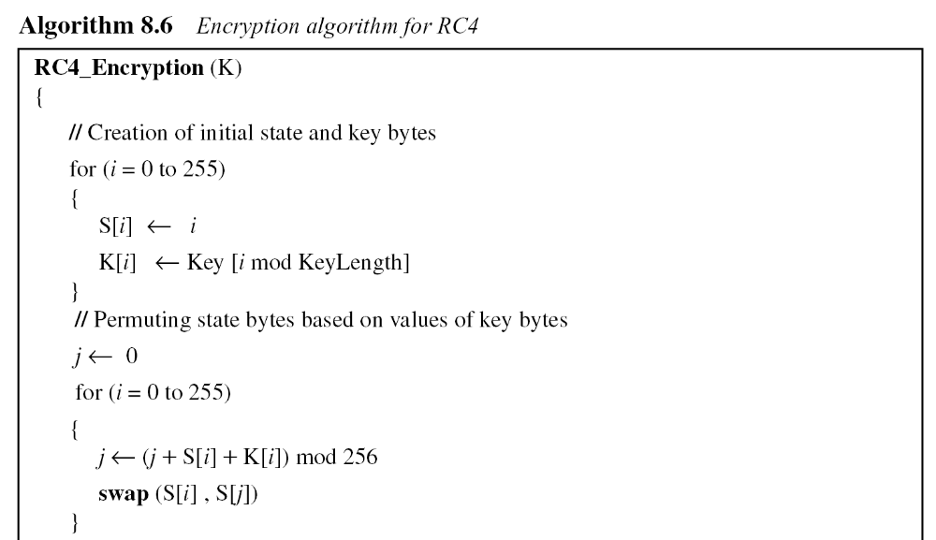
8.2.1 Continued
Algorithm
8.<number>

Slide 33
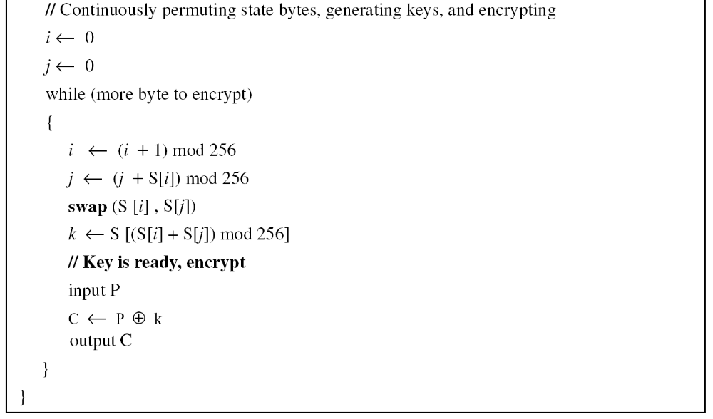
8.2.1 Continued
Algorithm Continued
8.<number>

Slide 34
8.2.1 Continued
Example 8.5
To show the randomness of the stream key, we use a secret key with all bytes set to 0. The key stream for 20 values of k is (222, 24, 137, 65, 163, 55, 93, 58, 138, 6, 30, 103, 87, 110, 146, 109, 199, 26, 127, 163).
Example 8.6
Repeat Example 8.5, but let the secret key be five bytes of (15, 202, 33, 6, 8). The key stream is (248, 184, 102, 54, 212, 237, 186, 133, 51, 238, 108, 106, 103, 214, 39, 242, 30, 34, 144, 49). Again the randomness in the key stream is obvious.
8.<number>

Slide 35
Security:
The key length – 256 bytes (maximum)
RC4 is secure
if the key size >=128 bits (16 bytes)
Applications:
BitTorrent protocol encryption
Microsoft Point-to-Point Encryption
Opera Mini
Secure Sockets Layer (optionally)
Secure shell (optionally)
Remote Desktop Protocol
Kerberos (optionally)
8.<number>

Slide 36
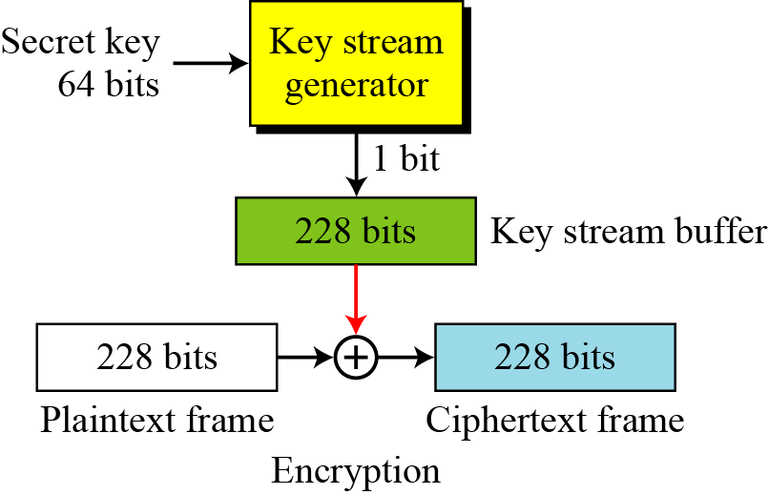
8.2.2 A5/1
A5/1 was developed in 1987.
A5/2 was developed in 1989.
A5/1 (a member of the A5 family of ciphers) is used in the Global System for Mobile Communication (GSM).
8.<number>
Figure 8.11 General outline of A5/1

Slide 37
GSM Security
3 algorithms specified in GSM
– A3 for authentication (“secret”, open interface)
– A5 for encryption (standardized)
– A8 for key generation (“secret”, open interface)
8.<number>

Slide 38
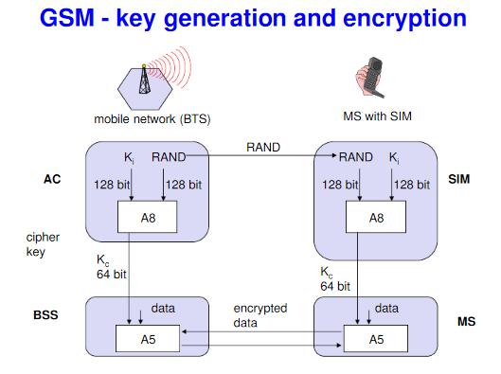
GSM :A8 is used for key generation
A5 for encryption
AC
A8
SIM
A8
K= 64 bit k = 64 bits
DATA DATA
encrypted data
BSS
MS
A5
A5
8.<number>

Slide 39
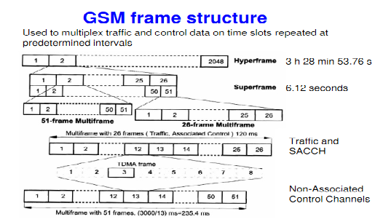
8.<number>

Slide 40
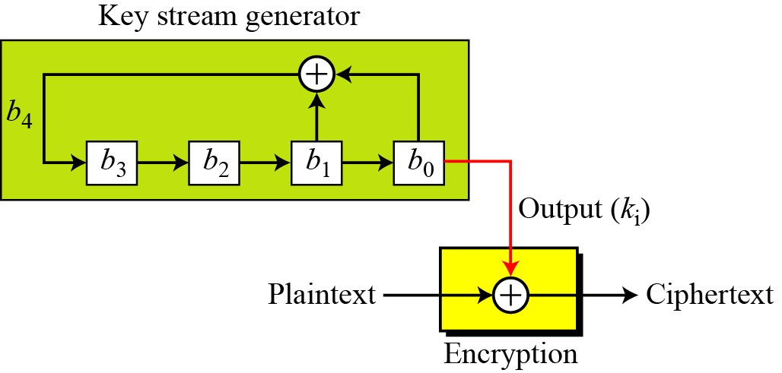
5.2.1 Continued
Example 5.19
Create a linear feedback shift register (LFSR) with 4 cells in which b₄ = b₁ ⊕ b₀. Show the value of output for 20 transitions (shifts) if the seed is (0001)₂.
Solution
Figure 5.25 LFSR for Example 5.19
8.<number>

Slide 41
5.2.1 Continued
Example 5.19
Table 5.6 Cell values and key sequence for Example 5.19
8.<number>

Slide 42
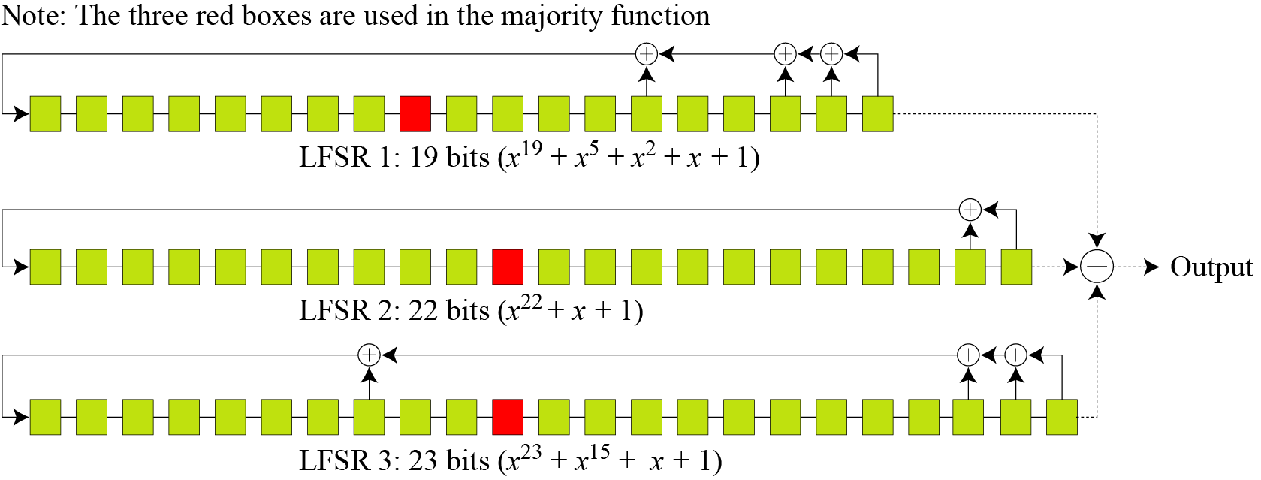
8.2.2 Continued
Key Generator
A5/1 uses three LFSRs with 19, 22, and 23 bits.
Figure 8.12 Three LFSR’s in A5/1
8.<number>

Slide 43
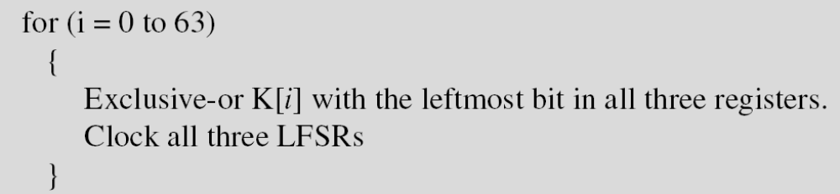
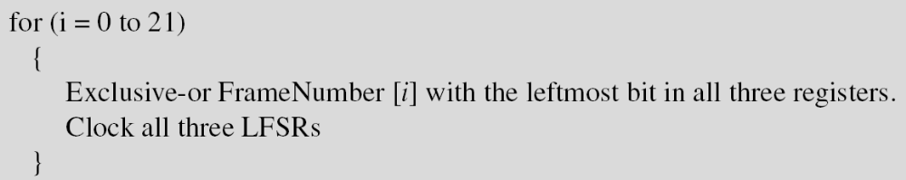
8.2.2 Continued
Initialization
1. Set all bits in three LFSRs to 0.
2. Mix the 64 bit key with the register
Clocking means shifting of one bit
3. Repeat the previous process but using 22 bit frame
8.<number>

Slide 44
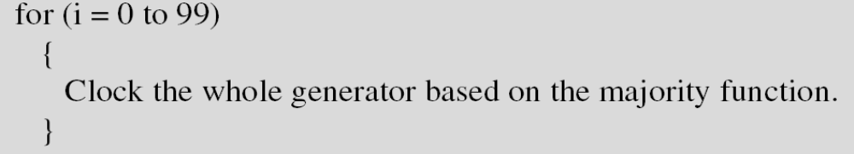
8.2.2 Continued
4.
8.<number>

Slide 45
Majority function
The registers are clocked in a stop/go fashion
using a majority rule.
Each register has an associated clocking bit.
At each cycle, the clocking bit of all three registers is examined and the majority bit is determined.
A register is clocked if the clocking bit agrees with the majority bit.
Hence at each step two or three registers are clocked, and each register steps with probability 3/4
Majority no. of bits
i.e. Majority(1,0,1)=1
Majority(0,0,1)=0
8.<number>

Slide 46
The Three shift registers are specified as follows:
LFSR number | Length in bits | Characteristic polynomial | Clocking bit | Tapped bits
1 | 19 | x¹⁹ + x⁵ + x² + x + 1 | 11 | 0,1,2, 5, 19
2 | 22 | x²² + x + 1 | 12 | 0, 1, 22
3 | 23 | x²³ + x¹⁵ + x + 1 | 13 | 0, 1, 15, 23
8.<number>

Slide 47
8.2.2 Continued
Example 8.7
At a point of time the clocking bits are 1, 0, and 1. Which LFSR is clocked (shifted)?
Solution
The result of Majority (1, 0, 1) = 1. LFSR1 and LAFS3 are shifted,
but LFSR2 is not.
Majority (0, 0, 0)=?
Majority (1, 1, 1)=?
8.<number>

Slide 48
8.2.2 Continued
Encryption/Decryption
The bit streams created from the key generator are buffered to form a 228-bit key
that is exclusive-ored with the plaintext frame to create the ciphertext frame. Encryption/decryption is done one frame at a time.
8.<number>

Slide 49
Multiple versions of the A5 algorithm exist which implement various levels of encryption.
A5/0 utilizes no encryption.
A5/1 is the original A5 algorithm used in Europe.
A5/2 is a weaker encryption algorithm created for export and used in the United States.
A5/3 is a strong encryption algorithm created as part of the 3rd Generation Partnership Project (3GPP).
  KASUMI is used in the A5/3 key stream generator
  used in UMTS, GSM, and GPRS mobile communications systems
8.<number>

Slide 50
8.3.2 Key Generation
Different symmetric-key ciphers need keys of different sizes. The selection of the key must be based on a systematic approach to avoid a security leak. The keys need to be chosen randomly. This implies that there is a need for random (or pseudorandom) number generator.
8.<number>

